Slide 1
Chapter 7
Quadratic Functions and Equations

Slide 2
7.2 TRANSFORMATIONS
a. Given the graph of a function, graph its transformation under translations, reflections, stretchings, and shrinkings.

Slide 3
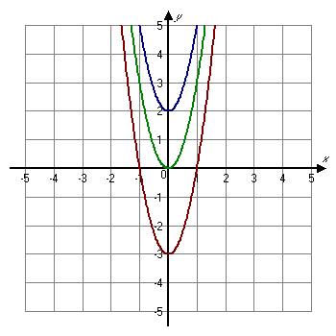
Vertical Translation
Vertical Translation
For b > 0,
the graph of y = f(x) + b is the graph of y = f(x) shifted up b units;
the graph of y = f(x) − b is the graph of y = f(x) shifted down b units.
y = 3x² +2
y = 3x²
y = 3x² – 3

Slide 4
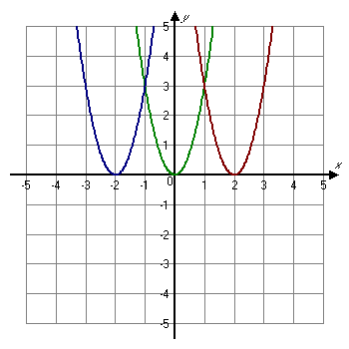
Horizontal Translation
Horizontal Translation
For d > 0,
the graph of y = f(x − d) is the graph of y = f(x) shifted right d units;
the graph of y = f(x + d) is the graph of y = f(x) shifted left d units.
y = (3x – 2)²
y = (3x + 2)²
y = 3x²

Slide 5
Reflections
The graph of y = −f(x) is the reflection of the graph of y = f(x) across the x-axis.
The graph of y = f(−x) is the reflection of the graph of y = f(x) across the y-axis.
If a point (x, y) is on the graph of y = f(x), then (x, −y) is on the graph of y = −f(x), and (−x, y) is on the graph of y = f(−x).

Slide 6
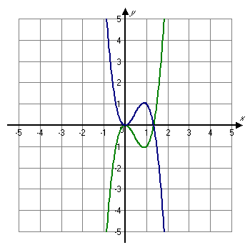
Reflection of the graph y = 3x³ − 4x² across the
x-axis.
y = 3x³ − 4x²
y = −3x³ + 4x²

Slide 7
Reflection of the graph y = x³ − 2x² across the
y-axis.
y = -x³ + 2x²
y = x³ − 2x²

Slide 8
Vertical Stretching and Shrinking
The graph of y = af (x) can be obtained from the graph of y = f(x) by
stretching vertically for |a| > 1, or
shrinking vertically for 0 < |a| < 1.
For a < 0, the graph is also reflected across the x-axis.
(The y-coordinates of the graph of y = af (x) can be obtained by multiplying the y-coordinates of y = f(x) by a.)

Slide 9
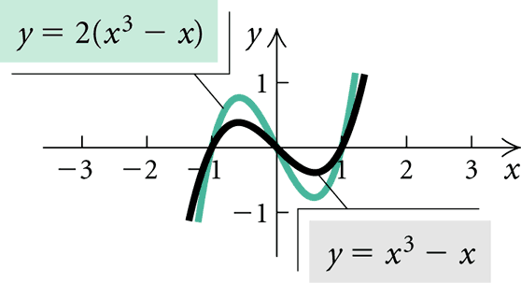
Stretch y = x³ – x vertically.

Slide 10
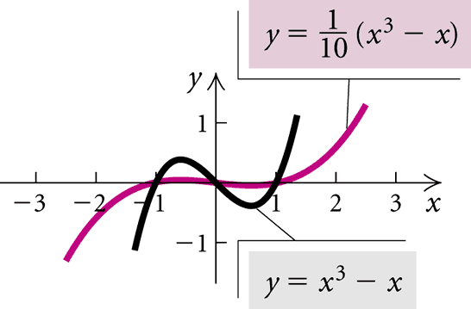
Shrink y = x³ – x vertically.

Slide 11
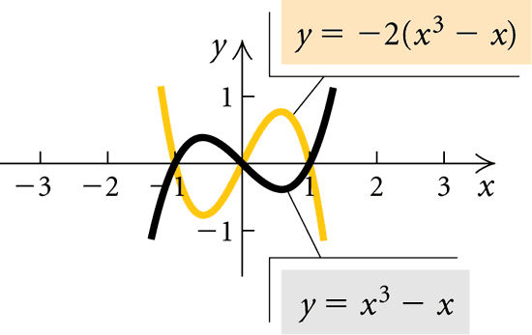
Stretch and reflect y = x³ – x across the x –axis.

Slide 12
Horizontal Stretching or Shrinking
The graph of y = f(cx) can be obtained from the graph of y = f(x) by
shrinking horizontally for |c| > 1, or
stretching horizontally for 0 < |c| < 1.
For c < 0, the graph is also reflected across the y-axis.
(The x-coordinates of the graph of y = f(cx) can be obtained by dividing the x-coordinates of the graph of y = f(x) by c.)

Slide 13
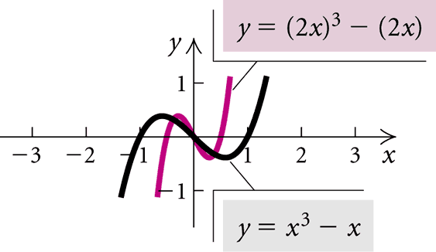
Shrink y = x³ – x horizontally.

Slide 14
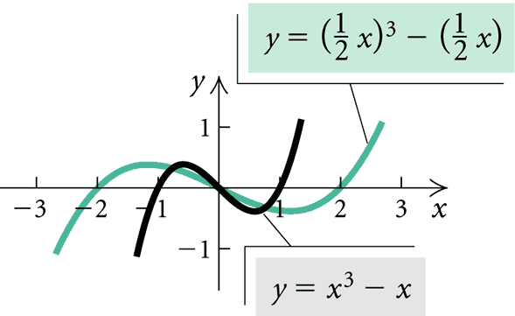
Stretch y = x³ – x horizontally.

Slide 15
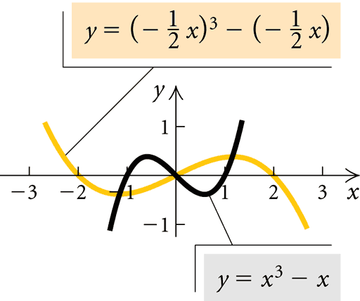
Stretch horizontally and reflect y = x³ – x.

