Slide 1
Chapter 9
Exponential Functions and Logarithmic Functions

Slide 2
9.2 INVERSE FUNCTIONS
a. Determine whether a function is one-to-one, and if it is, find a formula for its inverse.
b. Simplify expressions of the type and

Slide 3
Inverses
When we go from an output of a function back to its input or inputs, we get an inverse relation. When that relation is a function, we have an inverse function.
Interchanging the first and second coordinates of each ordered pair in a relation produces the inverse relation.
Consider the relation h given as follows:
h = {(−8, 5), (4, −2), (–7, 1), (3.8, 6.2)}.
The inverse of the relation h is given as follows:
{(5, −8), (–2, 4), (1, –7), (6.2, 3.8)}.
Notes:
3

Slide 4
Inverse Relation: Ordered Pairs
Interchanging the first and second coordinates of each ordered pair in a relation produces the inverse relation.
Notes:
4

Slide 5
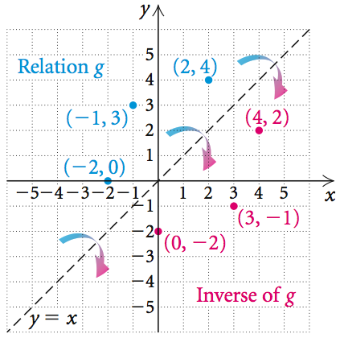
Consider the relation g given by
g = {(2, 4), (–1, 3), (−2, 0)}.
Graph the relation in blue. Find the inverse and graph it in red.
Solution: The relation g is shown in blue. The inverse of the relation is
{(4, 2), (3, –1), (0, −2)} and is shown in red. The pairs in the inverse are reflections of the pairs in g across the line y = x.
Notes:
5

Slide 6
Inverse Relation: Equation
If a relation is defined by an equation, interchanging the variables produces an equation of the inverse relation.
Notes:
6

Slide 7
Find an equation for the inverse of the relation:
y = x² − 2x.
Solution: We interchange x and y and obtain an equation of the inverse:
x = y² − 2y.
Graphs of a relation and its inverse are always reflections of each other across the line y = x.
Notes:
7

Slide 8
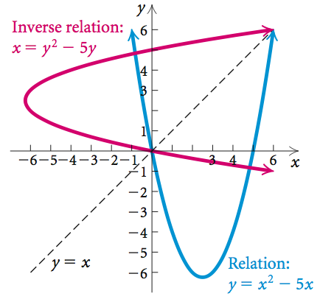
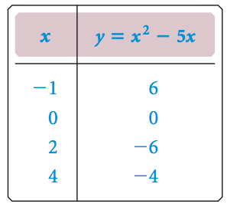
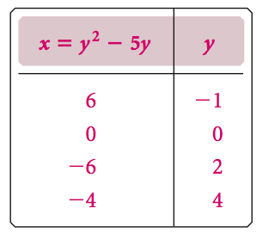
Graphs of a Relation and Its Inverse
If a relation is given by an equation, then the solutions of the inverse can be found from those of the original equation by interchanging the first and second coordinates of each ordered pair. Thus the graphs of a
relation and its inverse are always reflections of each other across the line y = x.
Notes:
8

Slide 9
One-to-One Functions
A function f is one-to-one if different inputs have different outputs – that is,
if a ≠ b, then f (a) ≠ f (b).
Or a function f is one-to-one if when the outputs are the same, the inputs are the same – that is,
if f (a) = f (b), then a = b.
Notes:
9

Slide 10
Inverses of Functions
If the inverse of a function f is also a function, it is named f ⁻¹ and read “f-inverse.”
The –1 in f ⁻¹ is not an exponent.
f ⁻¹ does not mean the reciprocal of f and f ⁻¹(x) can
not be equal to
Notes:
10

Slide 11
One-to-One Functions and Inverses
If a function f is one-to-one, then its inverse f ⁻¹ is a function.
The domain of a one-to-one function f is the range of the inverse f ⁻¹.
The range of a one-to-one function f is the domain of the inverse f ⁻¹.
A function that is increasing over its domain or is decreasing over its domain is a one-to-one function.
Notes:
11

Slide 12
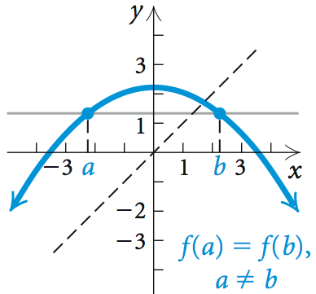
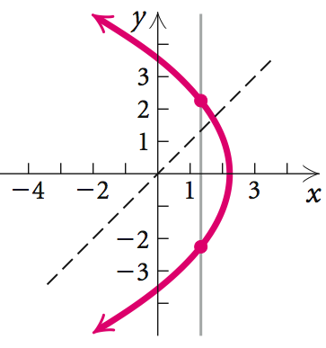
Horizontal-Line Test
If it is possible for a horizontal line to intersect the graph of a function more than once, then the function is not one-to-one and its inverse is not a function.
not a one-to-one function
inverse is not a function
Notes:
12

Slide 13
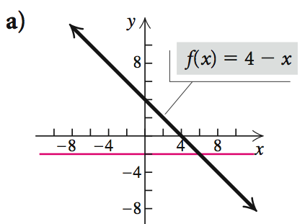
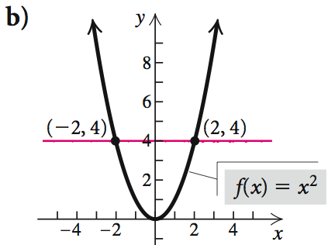
From the graph shown, determine whether each function is one-to-one and thus has an inverse that is a function.
No horizontal line intersects more than once: is one-to-one; inverse is a function
Horizontal lines intersect more than once: not one-to-one; inverse is not a function
Notes:
13

Slide 14
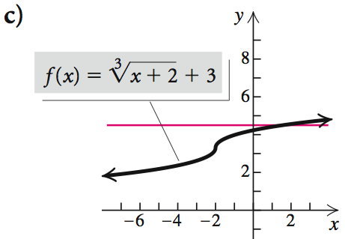
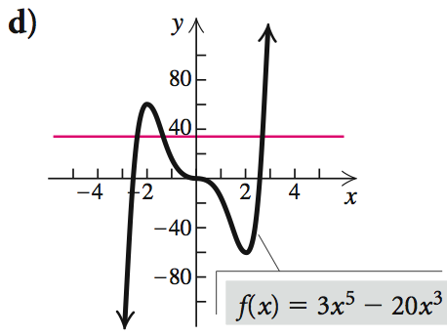
continued
From the graph shown, determine whether each function is one-to-one and thus has an inverse that is a function.
No horizontal line intersects more than once: is one-to-one; inverse is a function
Horizontal lines intersect more than once: not one-to-one; inverse is not a function
Notes:
14

Slide 15
Obtaining a Formula for an Inverse
If a function f is one-to-one, a formula for its inverse can generally be found as follows:
Replace f (x) with y.
Interchange x and y.
Solve for y.
Replace y with f ⁻¹(x).
Notes:
15

Slide 16
Determine whether the function f (x) = 2x − 3 is one-to-one, and if it is, find a formula for f ⁻¹(x).
Solution: The graph is that of a line and passes the horizontal-line test. Thus it is one-to-one and its inverse is a function.
1. Replace f (x) with y:
y = 2x − 3
2. Interchange x and y:
x = 2y − 3
3. Solve for y:
x + 2 = 3y
4. Replace y with f ⁻¹(x):
Notes:
16

Slide 17
continued
Graph
using the same set of axes. Then compare the two graphs.
Notes:
17

Slide 18
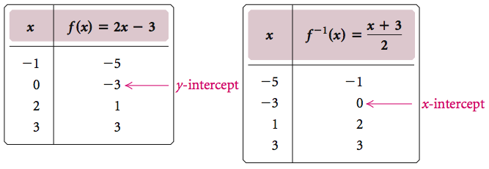
continued
Solution: The solutions of the inverse function can be found from those of the original function by interchanging the first and second coordinates of each ordered pair.
Notes:
18

Slide 19
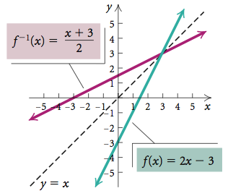
continued
The graph f ⁻¹ is a reflection of the graph f across the line y = x.
Notes:
19

Slide 20
Inverse Functions and Composition
If a function f is one-to-one, then f ⁻¹ is the unique function such that each of the following holds:
for each x in the domain of f, and
for each x in the domain of f ⁻¹.
Notes:
20

Slide 21
Given that f (x) = 5x + 8, use composition of functions
to show that
Solution:
Notes:
21

Slide 22
Restricting a Domain
When the inverse of a function is not a function, the domain of the function can be restricted to allow the inverse to be a function. In such cases, it is convenient to consider “part” of the function by restricting the domain of f (x).
Suppose we try to find a formula for the inverse of
f (x) = x².
This is not the equation of a function because an input of 4 would yield two outputs, 2 and 2.
Notes:
22

Slide 23
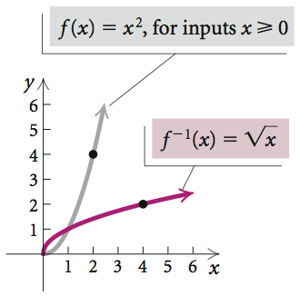
Restricting a Domain
However, if we restrict the domain of f (x) = x² to nonnegative numbers, then its inverse is a function.
Notes:
23

