Slide 1
Verify that
, where c is an arbitrary
constant, is a one-parameter family of solutions to
Graph the solution curves corresponding to c = 0, ±1, ±2 using the same coordinate axes.

Slide 4
Graph the solution curves corresponding to c = 0, ±1, ±2 using the same coordinate axes.

Slide 5
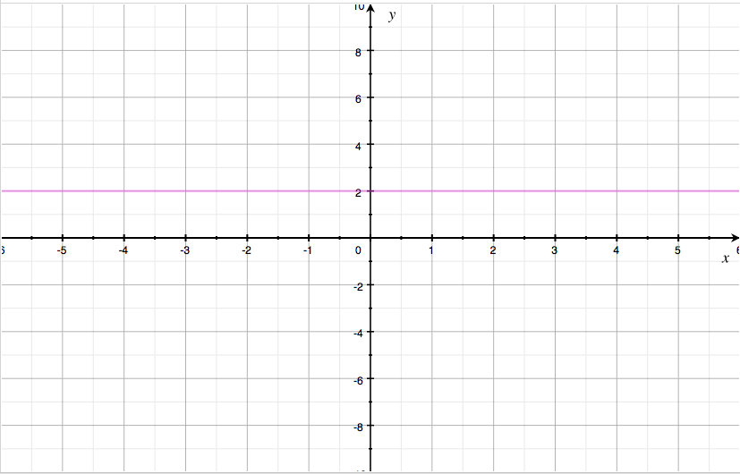

Slide 6
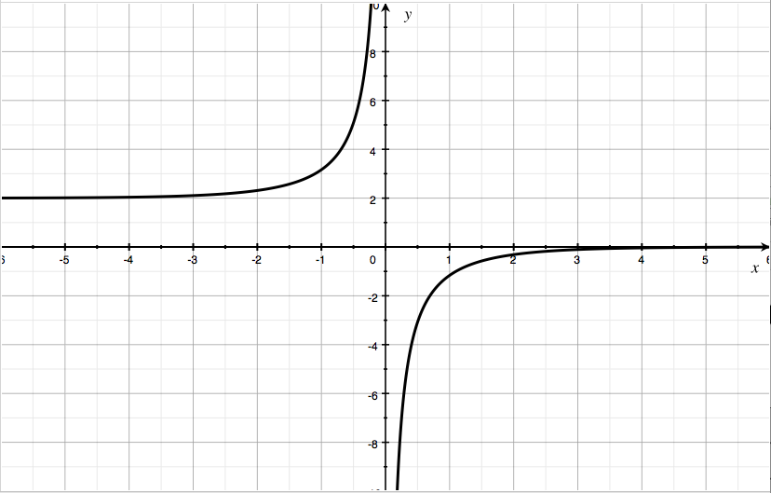

Slide 7
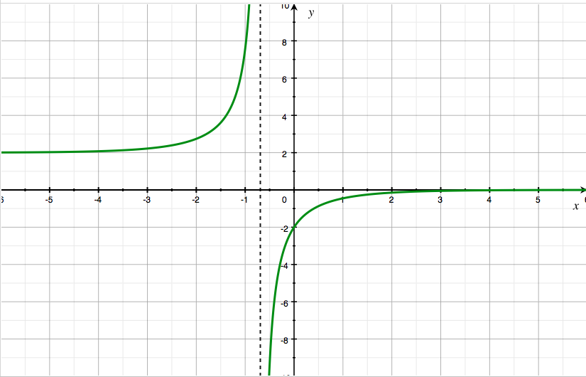

Slide 8
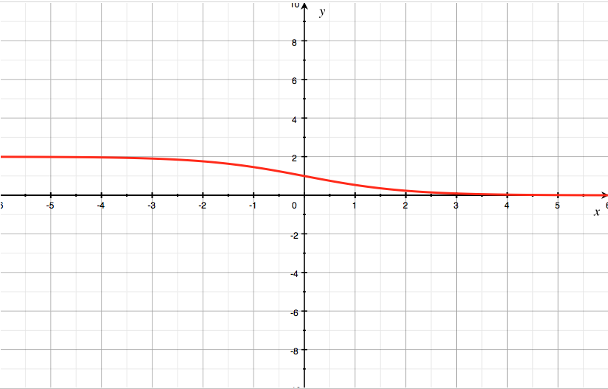

Slide 9
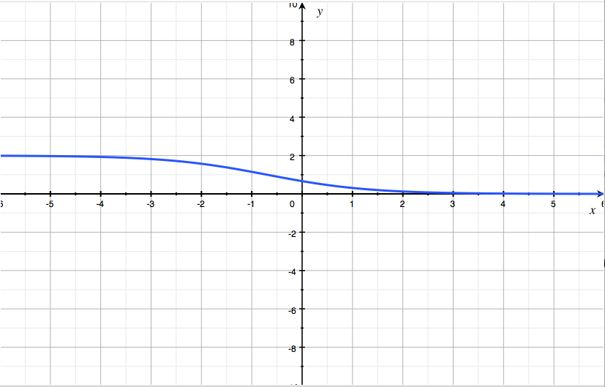

Slide 10
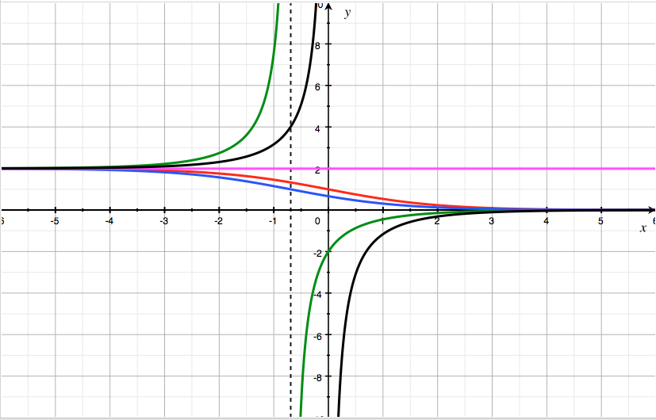
Values of c:
0, ±1, ±2
+2
+1
0
–2
–1

