Slide 1
The logistic equation for the population (in thousands) of a certain species is given by

Slide 2
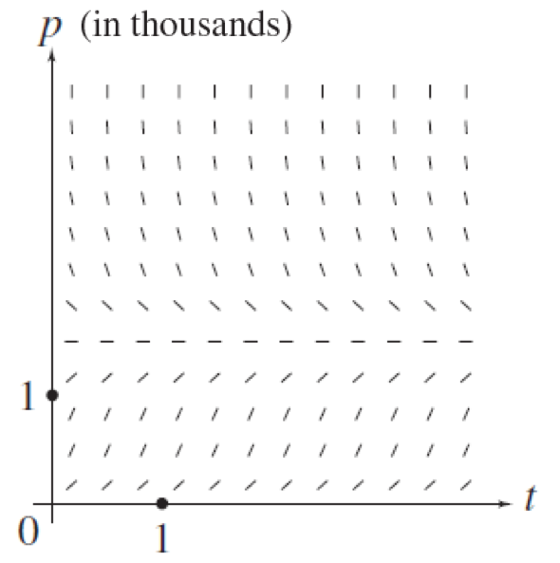
Sketch the direction field using computer software.

Slide 3
Sketch the direction field using the method of isoclines.
Isocline means equal inclination.
Along which curves are the slopes equal?
Slope
Constant slope implies constant p.

Slide 4
Constant slope implies constant p.
in thousands

Slide 5
in thousands

Slide 6
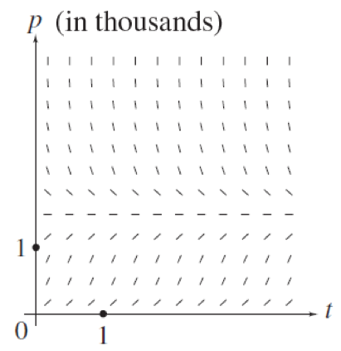
If the initial population is 3000 [that is, p(0) = 3], what can you say about the limiting population

Slide 7
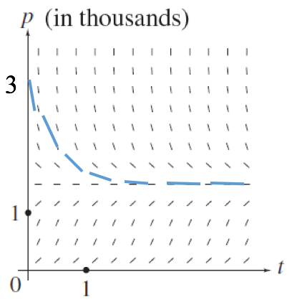
If the initial population is 3000 [that is, p(0) = 3], what can you say about the limiting population

Slide 8
If the initial population is 800 [that is, p(0) = 0.8], what can you say about the limiting population

Slide 9
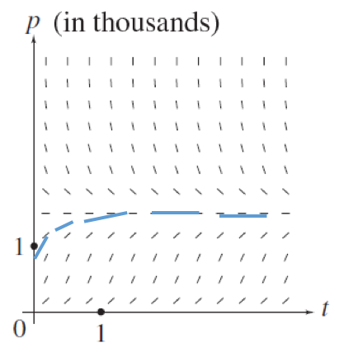
If the initial population is 800 [that is, p(0) = 0.8], what can you say about the limiting population

Slide 10
Can a population of 2000 ever decline to 800?

Slide 11
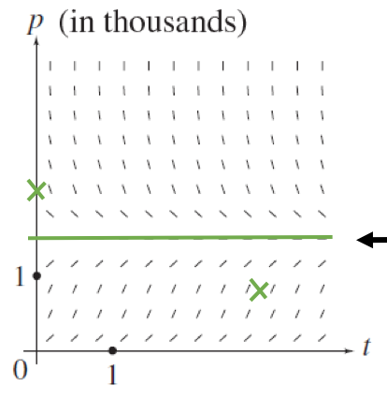
Can a population of 2000 ever decline to 800?
No. Only one solution can pass through these points.

